Slide 1
MAPS
Department of Geography
SGGSJ Govt.College Paonta Sahib

Slide 2
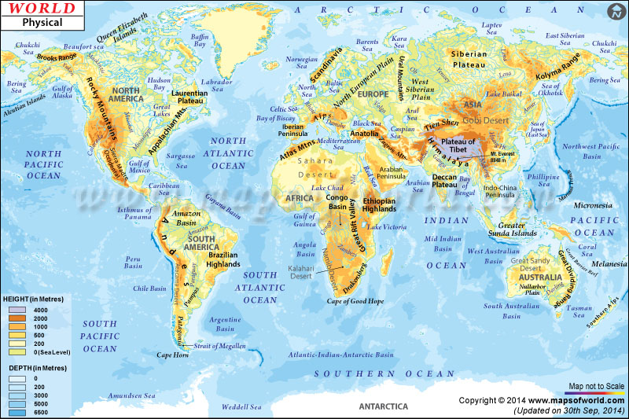
WORLD Maps: PHYSICAL-POLITICAL

Slide 3
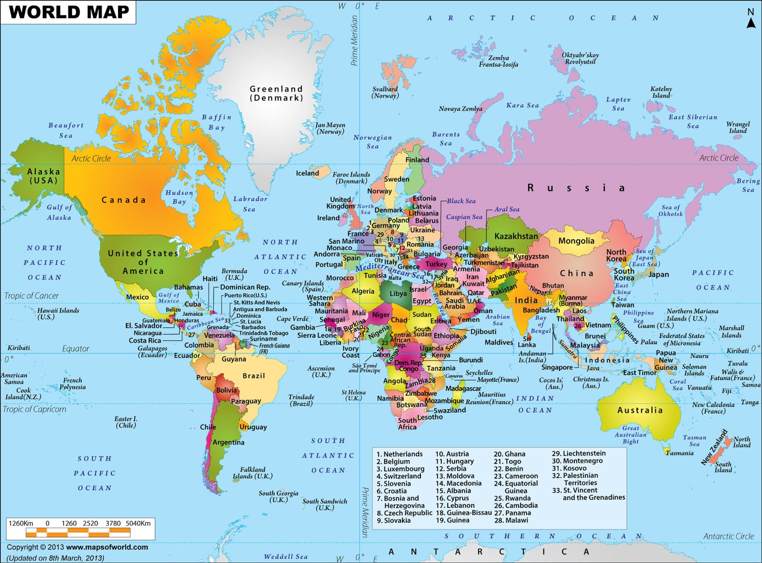

Slide 4
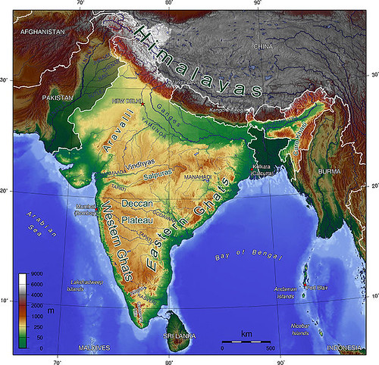
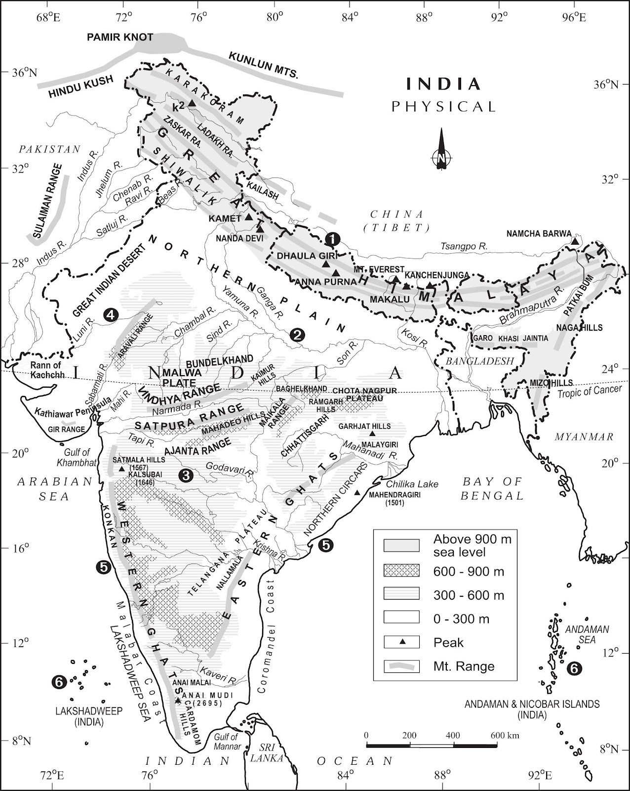
India: physical - political

Slide 5
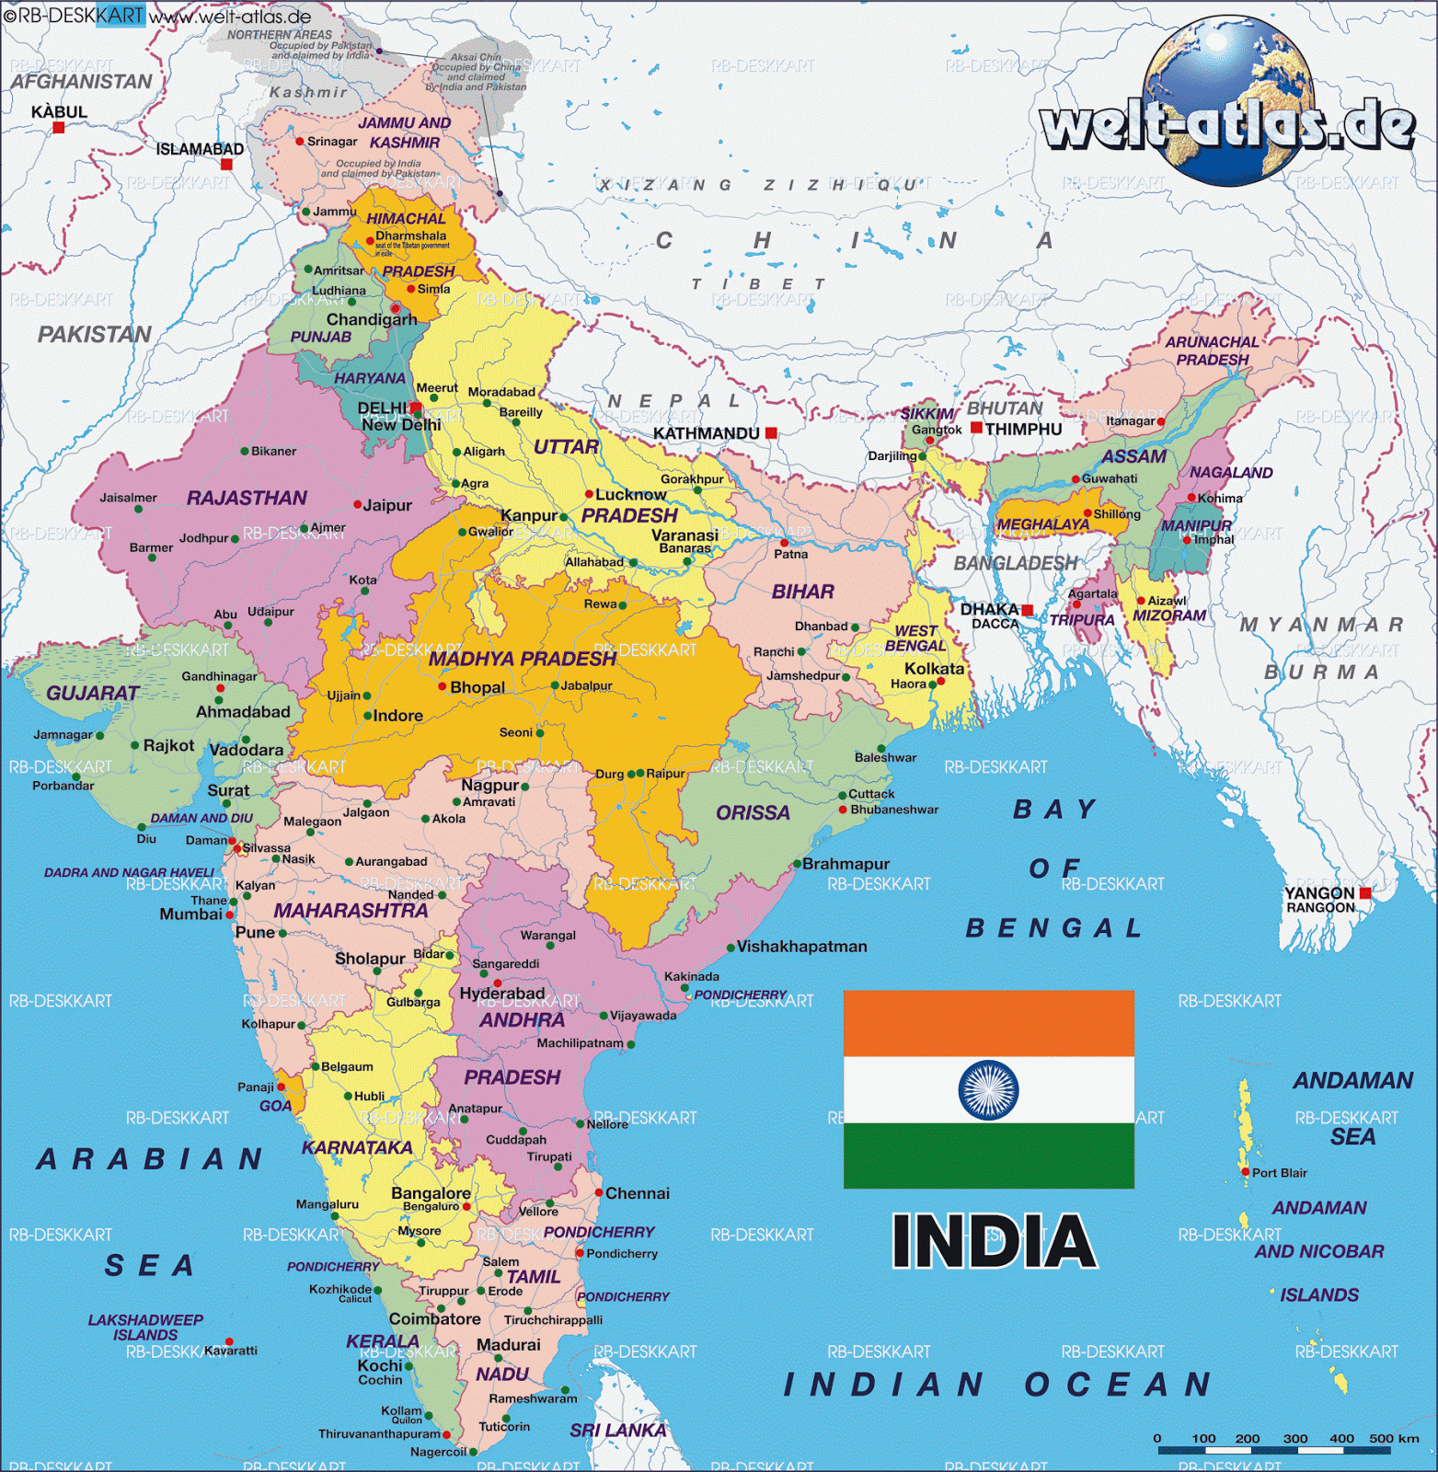
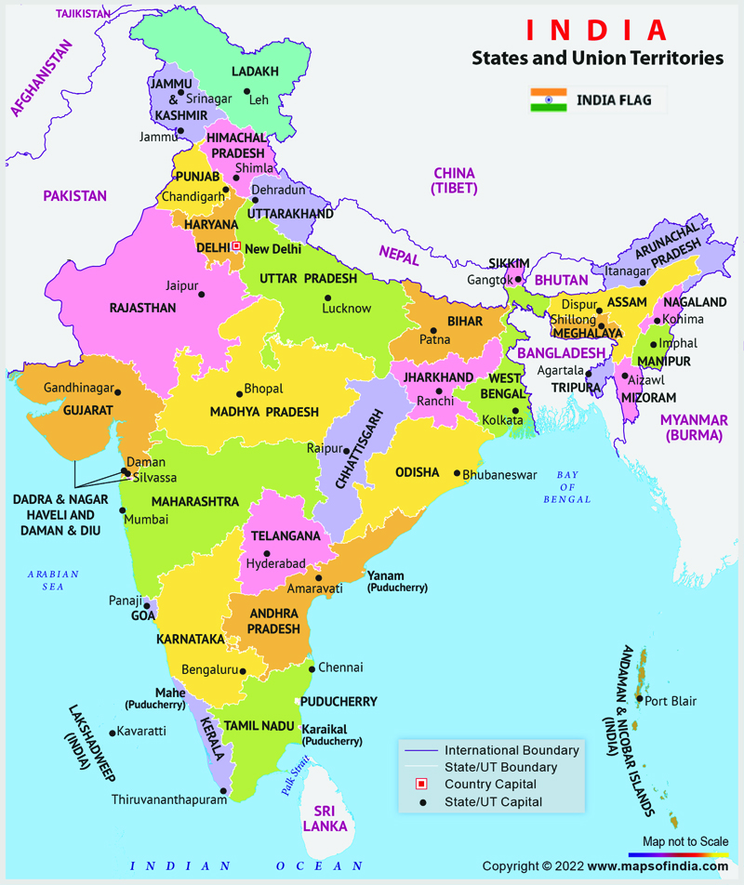

Slide 6
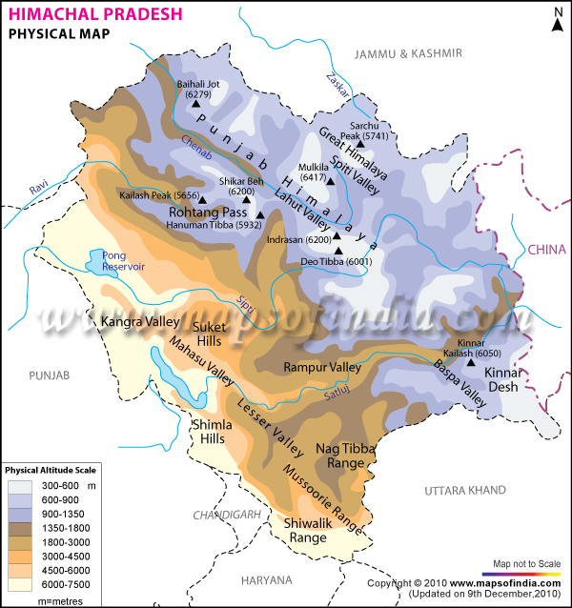
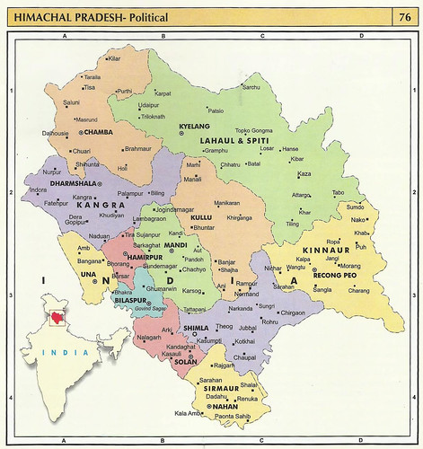
Himachal Pradesh: physical-political

Slide 7
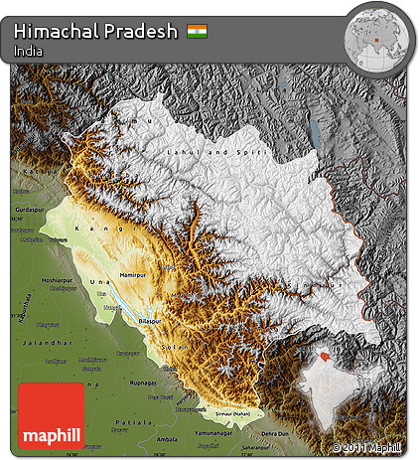
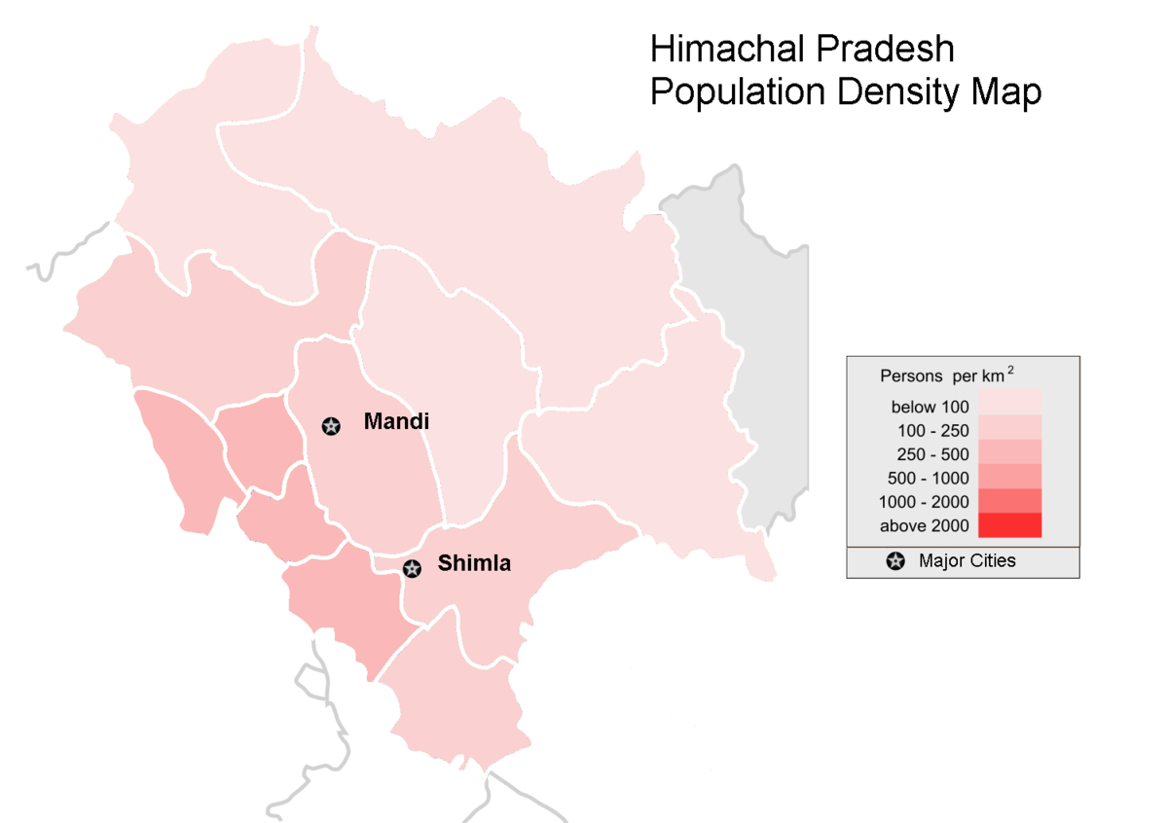
Himachal Pradesh: relief and population

Slide 8
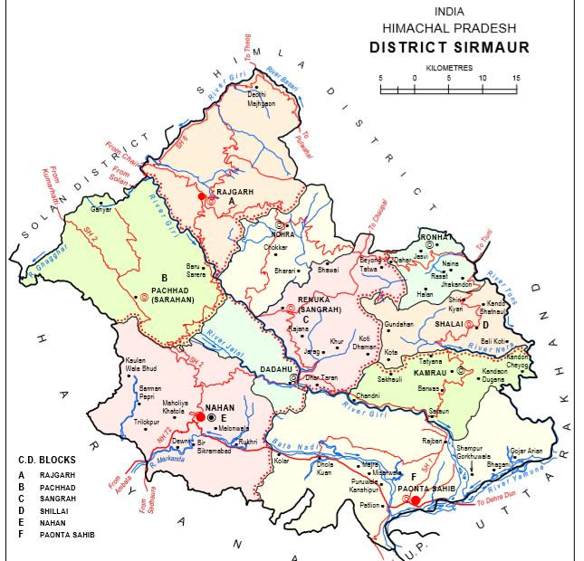
SIRMOUR: ADMINISTRATIVE SETUP

Slide 9
Thank you
Shree Guru Gobind Singh Ji
Government College Paonta Sahib

